Slide 1
Genre Sentiment Classification Based on Movie Reviews
Abdallah Adel 49-14632
Mohamed Kamal 46-7203

Slide 2
Presentation outline
Recap
Labeling
Models
Dataset
Challenges

Slide 3

Recap

Slide 4

The solution
“The movie was hilarious from start to finish. I laughed so hard that I cried. The humor was clever, and the jokes were well-timed.”
= FUNNY
The Nun, 2018

Slide 5
Challenges
Model Selection
Labeling
Integrity

Slide 6
Labeling

Slide 7
Labeling
Search for a dataset with labeled genres? Did not find.
Possible approaches:
Manual labeling.
Assign label based on the movie the review as wrote for (not applicable with the IMDB dataset).
Try to find patterns within reviews and group them based on their similarity (Clustering).

Slide 8
Manual Labeling
Choose specific N genres to categorize reviews into, where N is the number of genres our models/system can recognize.
Any review that doesn’t fit into genre of the N genres will be places in special category called Other.
Three different iterations for manual labeling.

Slide 9
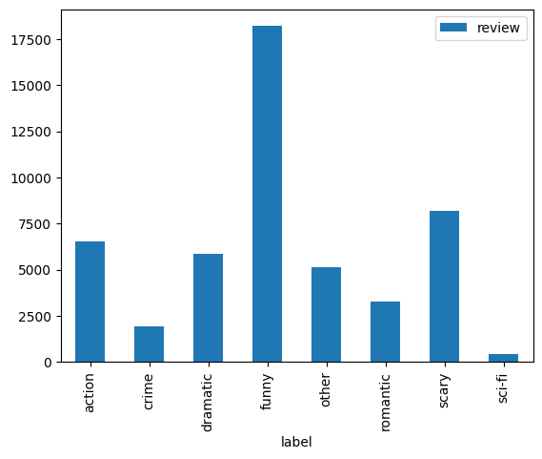
Manual Labeling
1st iteration:
Action
Crime
Dramatic
Funny
Romantic
Scary
Sci-fi
Other

Slide 10
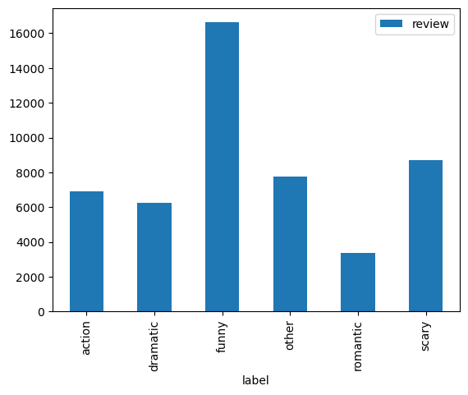
Manual Labeling
2nd iteration:
Action
Dramatic
Funny
Romantic
Scary
Other

Slide 11
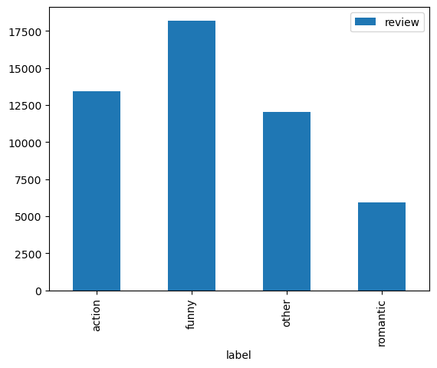
Manual Labeling
3rd iteration:
Action
Funny
Romantic
Other

Slide 12
Models

Slide 13
Models
To overcome model selection, 3 different model types were proposed and tested, which were:
K-means model.
KNN model.
LSTM model(s).

Slide 14
K-means model
For the K-means model, we used K = 6 to generate 6 clusters.
Each cluster would represent a category in the 2nd iteration of our manual labeling.
After training the K-means model, we had 6 unlabeled clusters that needed in depth review in order to correctly classify which genre they best represent, this is left for future work.
For now, we used the silhouette score to measure the model’s performance, it scored an average of -0.0117 score.

Slide 15
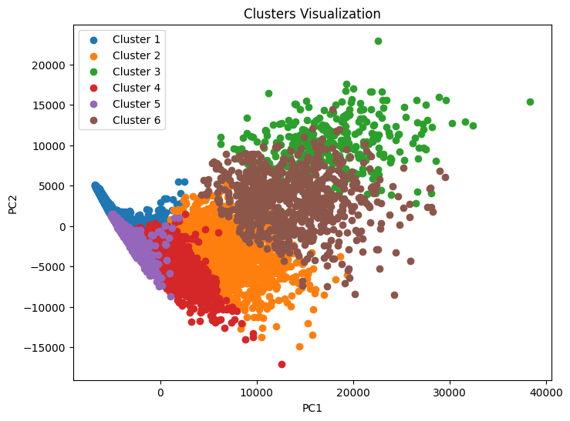
Representation of the 6 clusters generated by the K-means model.

Slide 16
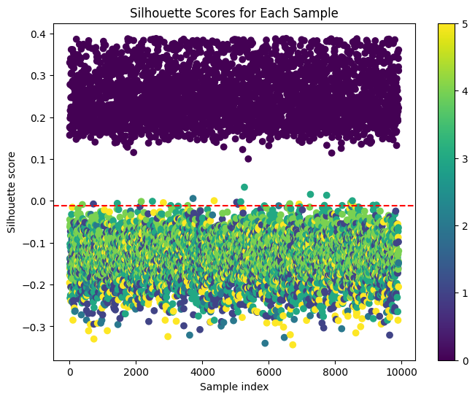
K-means silhouette score
Silhouette score measures how similar a data point in a cluster compared to other clusters.
It ranges from [-1, 1].
-1 means that the point maybe placed incorrectly in a cluster.
0 means that there exists overlapping between clusters.
1 means that clusters are well separated and dense.
Our model has an average of -0.0117.

Slide 17
KNN model
Just as the K-means model, we sought a KNN model for patterns matching, but this time supervised.
However, initial experimentation showed an average accuracy of ~10%, hence the model was quickly discarded and not progressed anymore.
2nd iteration of manual labeling was also used to label reviews for training here.

Slide 18
LSTM models
After experimenting on the KNN model, we pursued the basic approach of an LSTM model.
We had trained 2 models, the differences between both were:
For model 1, we used the 2nd iteration of manual labeling to label the input data, and it consisted of 3 LSTM layers.
For model 2, we used the 3rd iteration of manual labeling to label the input data, and it consisted of 1 LSTM layer.
Models architecture were: an input Embedding layer, LSTM layer(s) (each had 32 units), and a Dense layer for classification.

Slide 19
LSTM models
Model 1:
Training accuracy: 69.47%
Test accuracy: 66.57%
Precision: 63%
Recall: 67%
F1-score: 51%
Model 2:
Training accuracy: 72.98%
Test accuracy: 71.89%
Precision: 71%
Recall: 72%
F1-score: 69%

Slide 20
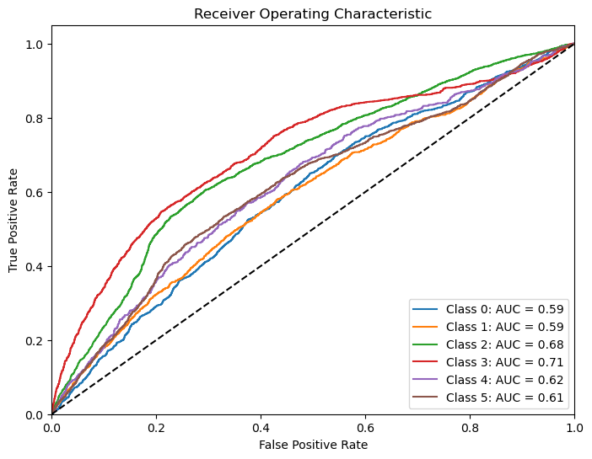
ROC curve for model 1 on the 6 genres, classes 0, 1, 2, 3, 4, 5 represent Action, Dramatic, Funny, Other, Romantic, and Scary respectively

Slide 21
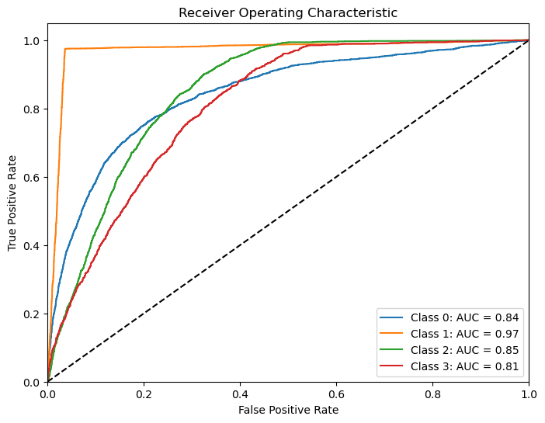
ROC curve for model 2 on the 4 genres, classes 0, 1, 2, and 3, represent Action, Funny, Other, and Romantic respectively

Slide 22

THANK YOU

